Slide 1
Finance and Accounts (MG-251) Optimal portfolio construction
Professor Shashi Jain
Dept of Management Studies
Presented by:
Akshay Dixit
Hrithik Singh
Susmit Das

Slide 2
Contents
Finding efficient frontier based on Monte-Carlo Simulations
Finding minimum risk portfolio using quadratic programming and Monte-Carlo Simulation
Finding optimal portfolio i.e., portfolio with highest Sharpe Ratio
Comparing optimal portfolio with market cap weighted portfolio
Discussing drawbacks and assumptions
Possible improvements
Using statistical methods to test robustness of established model

Slide 3
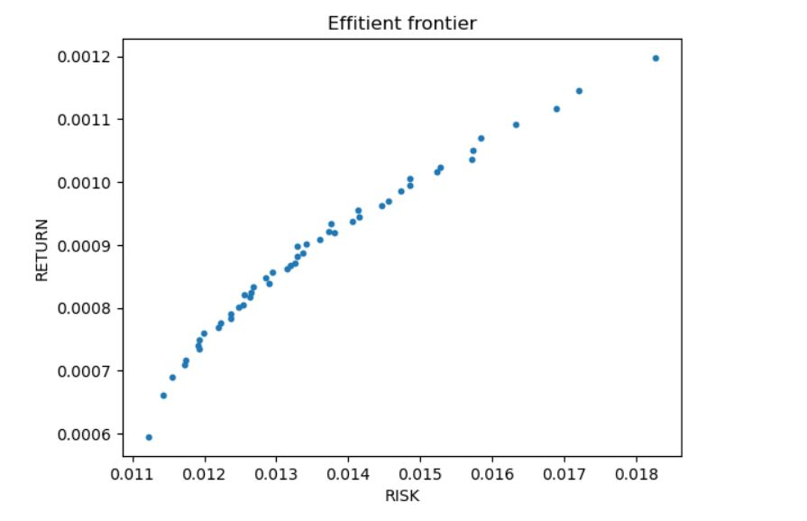
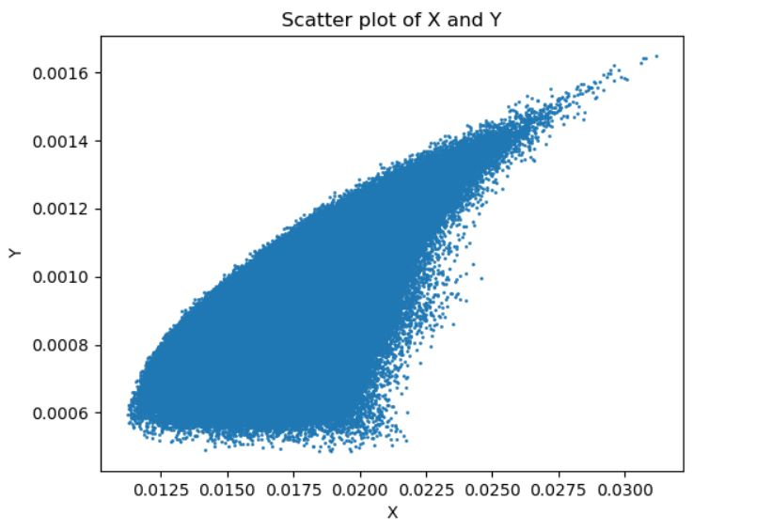
Efficient Frontier
Number of Portfolios Generated : 10,00,000

Slide 4
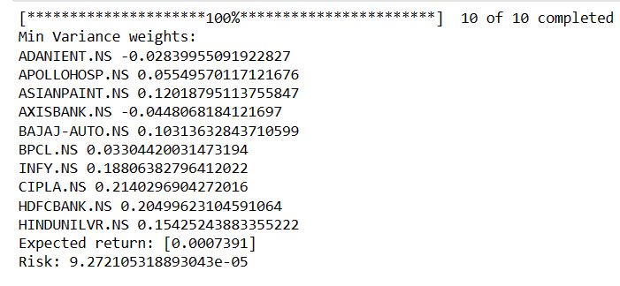

Minimum variance portfolio
Results obtained by quadratic programming for a 10 stock portfolio :
Similar minimum variance was obtained through Monte Carlo approach for the same 10 stock portfolio with a minimum variance of :

Slide 5
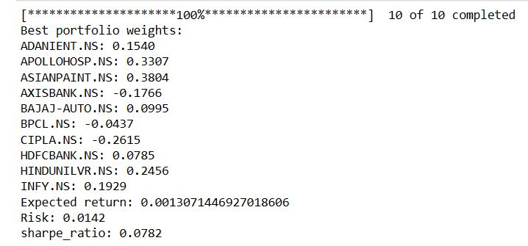
Best portfolio (highest sharpe ratio):

Slide 6
Best Portfolio vs NiFTY50 :
Generated best portfolio of stocks in NIFTY50 using historical returns (2010-01-01 to 2021-12-31).
Compared actual returns of NIFTY50 (2022-01-01 to till date) with the best portfolio obtained.
On an average NIFTY50 outperformed best portfolio 38% of the time.
In general, a portfolio with the highest Sharpe ratio is expected to outperform a market cap weighted portfolio over the long-term, as it is constructed to optimize risk-adjusted returns. However, this may not always be the case, as have been observed from the data since market conditions and individual stock performance can vary significantly.
CONCLUSION :

Slide 7
Assumptions :
Mean of daily returns of different stocks exist.
Monte Carlo simulation assumes that the return distributions of different assets are stationary over time. This may not be the case, as asset returns can exhibit time-varying volatility and correlation.

Slide 8
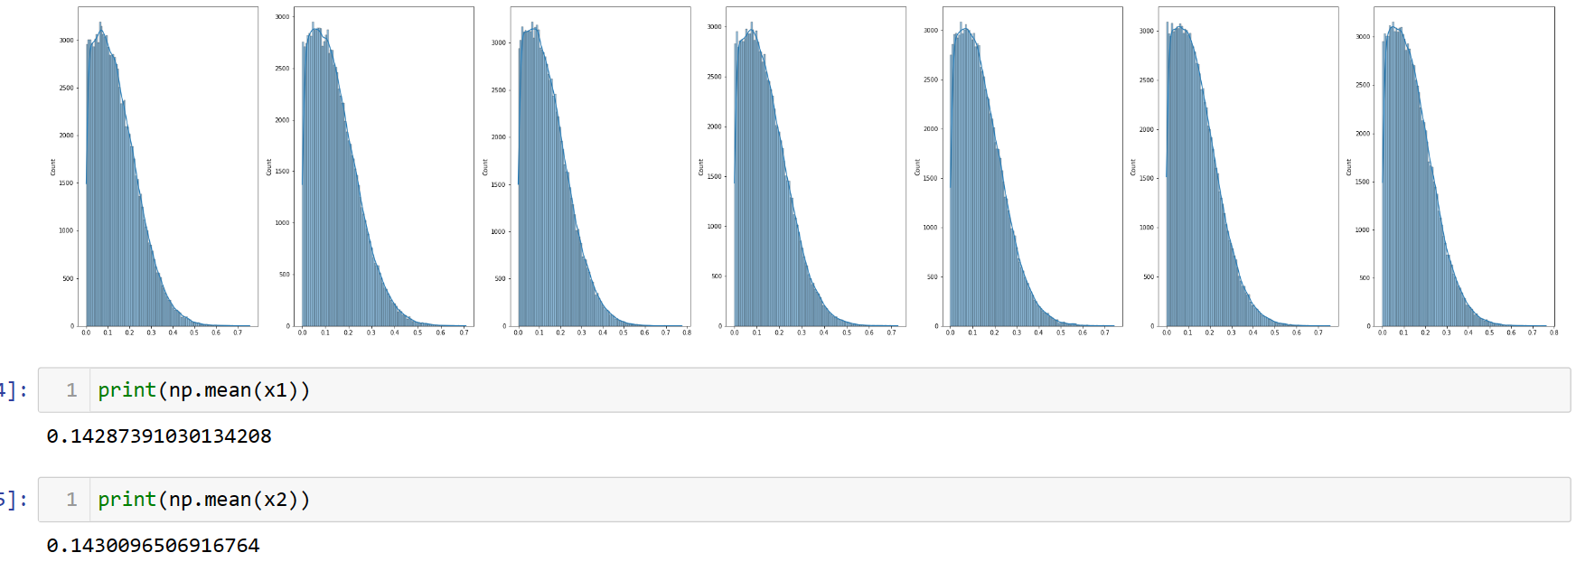
Drawbacks :
Distribution of weights generated is not uniform.

Slide 9
Drawbacks :
Monte Carlo simulation is based on historical data, which may not always be a reliable guide to future performance. The simulation results may be affected by changes in market conditions, such as shifts in economic fundamentals or changes in government policies.
Monte Carlo simulation requires a large number of simulations to achieve accurate results. As the number of assets in the portfolio increases, the computational complexity of the simulation also increases, making it time-consuming and computationally intensive

Slide 10
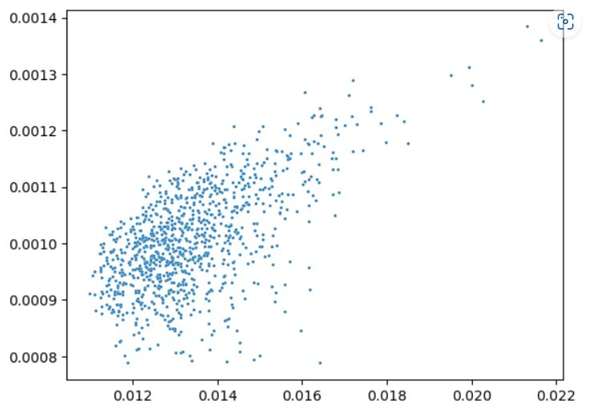
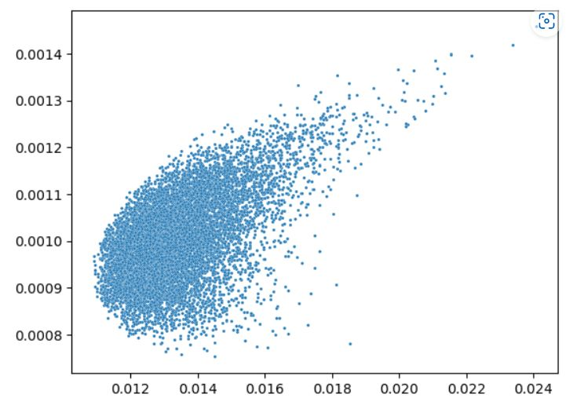
Drawbacks :
Scatter plot of 1,000 portfolios
Scatter plot of 10,000 portfolios

Slide 11
Possible improvements:
We can employ machine learning techniques like gaussian processes to predict future stock prices, thus partially reducing our dependencies on historical data.
Instead of using older data , we can use recent data to learn the correlation between the consecutive day’s stock prices by using a suitable combination of kernel functions.

Slide 12
Verifying results : a statistical Approach
Back-testing approach:
Compared Historical Results with simulated results.
Evaluated reliability of the simulation model.
Used extensive amount of historical data to obtain best portfolio to ensure robustness.

Slide 13
Methodology
Computed daily expected return of the best portfolio of stocks in NIFTY50 using historical returns (2010-01-01 to 2021-12-31).
Compared actual daily returns of NIFTY50 (2022-01-01 to till date) with the computed expected return of the best portfolio obtained.
NULL HYPOTHESIS : Daily Expected Return = its computed value.
ALTERNATE HYPOTHESIS : Daily Expected Return != its computed value.
Performed two-tailed z-test.
Reported p-value= 0.9191146

Slide 14
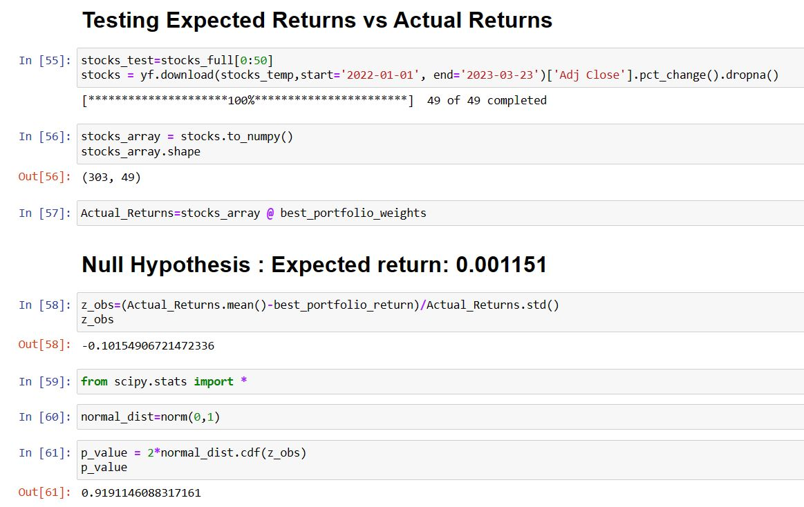

Slide 15
Conclusion :
Reported p-value indicates that there is hardly any evidence against the null hypothesis.
Hence the results obtained under the assumptions is reasonably valid, i.e. past returns are indeed a good predictor of expected future returns.

Slide 16
Thank You
Mathematical Formulation by Akshay Dixit
Hypothesis Formulation and Assumption Validation by Hrithik Singh
Code Implementation by Susmit Das

